Slide 1

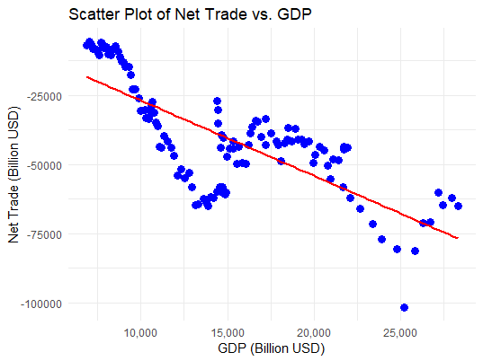
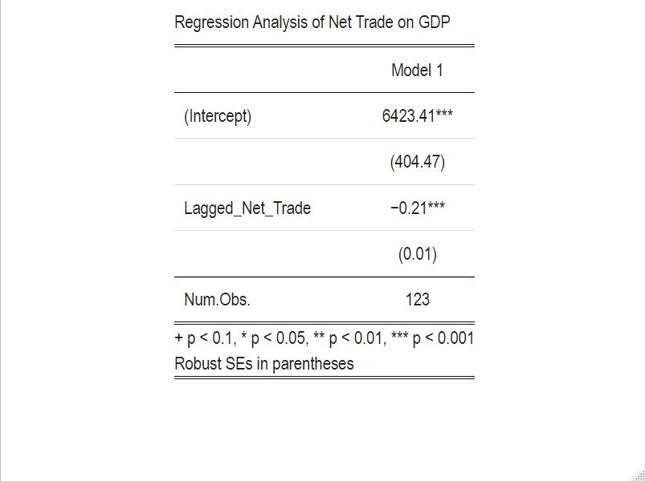
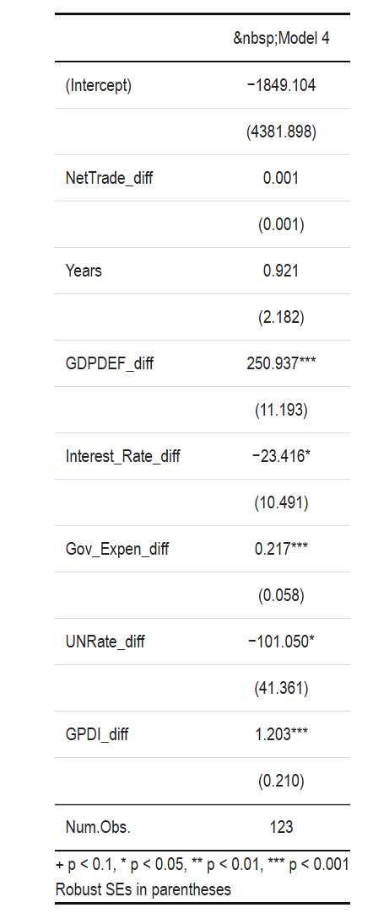
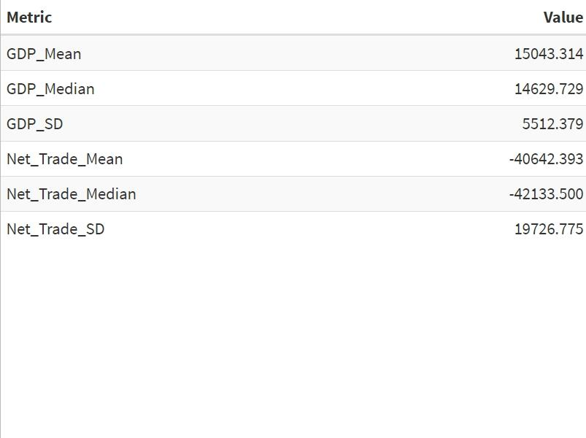
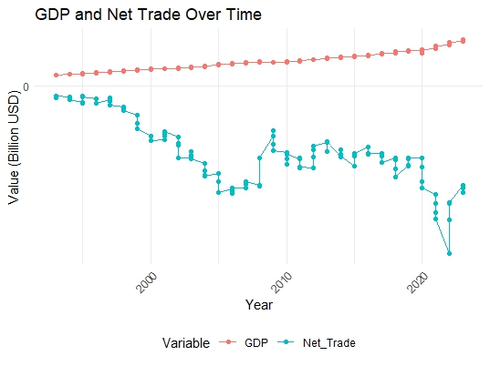
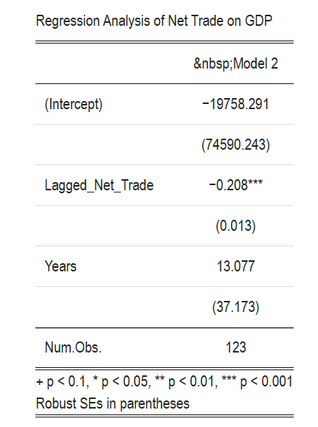
Exploring The Correlation Between Economic Growth And Trade Volumes in the US.
Ibrahim Quansah Graduate Student, University of Maine
Abstract
Scatter Plot
Regression Analysis
This study investigates the relationship between economic growth, measured by Gross Domestic Product (GDP), and trade volumes, specifically net trade, in the United States from 1993 to 2023. Using data from FRED and the World Bank, the analysis evaluates the correlation between these variables to understand their interplay and implications for economic policies. While GDP has demonstrated consistent growth over the period, net trade has remained relatively flat, reflecting a persistent trade deficit. Statistical analyses reveal a slight negative correlation between net trade and GDP, indicating that as GDP increases, net trade tends to decrease. The regression analysis further highlights that for every unit increase in the differenced net trade, GDP is expected to increase by approximately 0.005 units, holding other factors constant. Furthermore, regression models suggest that factors such as time, inflation, and private investment positively influence GDP, whereas higher interest rates and unemployment negatively impact economic growth.
Purpose: To identify whether a correlation exists between the two variables, meaning that changes in trade volumes might correlate with changes in economic growth (GDP).
This scatter plot examines the relationship between Net Trade and GDP. Here's a breakdown of the key observations:
Trend: The plot reveals a negative correlation between Net Trade and GDP. This means that as GDP increases, Net Trade tends to decrease.
Strength of the Relationship: While there's a clear negative trend, the points aren't tightly clustered around the line. This suggests that the relationship between Net Trade and GDP, while present, is not extremely strong. Other factors influence GDP besides Net Trade.
The regression analysis of net trade on GDP indicates that for every unit increase in lagged net trade (Lagged_Net_Trade), GDP is expected to decrease by approximately 0.21 units, holding other factors constant. This relationship is highly significant (p < 0.001), suggesting a strong negative impact of lagged net trade on GDP.
The regression analysis indicates that for every unit increase in the differenced net trade, GDP is expected to increase by approximately 0.001 units, holding other factors constant. Each additional year is associated with an increase in GDP by approximately 0.921 units. Time trend is not statistically significant. For every unit increase in the differenced GDP deflator, GDP is expected to increase by approximately 250.937 units, indicating that changes in price levels have a substantial positive impact on GDP. Conversely, for every unit increase in the differenced interest rate, GDP is expected to decrease by approximately 23.416 units, suggesting that higher interest rates reduce GDP. Similarly, a unit increase in the differenced unemployment rate leads to a decrease in GDP by approximately 101.050 units, highlighting the negative impact of higher unemployment. Additionally, for every unit increase in the differenced gross private domestic investment, GDP is expected to increase by approximately 1.203 units, indicating a positive relationship. Overall, the model underscores the significant positive contributions of time, inflation, and private investment to GDP, while higher interest rates and unemployment negatively impact GDP.
Summary statistics for GDP and Net Trade
GDP and Net Trade trends in the US from 1993 to 2023.
Regression Analysis
Key Takeaways:
GDP is generally much larger than Net Trade: This reinforces the idea that Net Trade plays a relatively smaller role in the overall US economy compared to GDP.
GDP shows greater variability: The higher standard deviation of GDP compared to Net Trade indicates that GDP fluctuates more over time.
Consistent Trade Deficit: The negative mean and median for Net Trade suggest a persistent trade deficit for the US during the analyzed period.
GDP
GDP has shown a consistent upward trend over two decades, reflecting strong economic growth, despite temporary slowdowns. Notable periods of flattened growth occurred around 2008-2009, likely due to the global financial crisis, and in 2020, likely due to the COVID-19 pandemic. However, the overall trajectory remains positive.
Net Trade
Remains relatively flat and close to zero throughout the entire period.
This suggests that the value of US exports and imports has been roughly balanced for most of the time frame.
There are minor fluctuations, but no significant or sustained trends in either direction.
For every unit increase in Lagged_Net_Trade, GDP decreases by 0.208 units, holding Years constant. This negative coefficient suggests a slight inverse relationship between Lagged_Net_Trade and GDP.
This relationship is statistically significant at the 1% level (p < 0.01). There is robust evidence supporting this inverse relationship.
For every one-year increase, GDP increases by 13.077 units, holding Lagged_Net_Trade constant. This positive coefficient implies that GDP has been growing over time, regardless of changes in net trade.
References
Worldbank Open Data. https://data.worldbank.org/indicator/BN.GSR.MRCH.CD?end=2023&locations=US&start=1970&view=chart
FRED
Gross Private Domestic Investment (GPDI) | FRED | St. Louis Fed
The University of Maine does not discriminate on the grounds of race, color, religion, sex, sexual orientation, including transgender status and gender expression, national origin, citizenship status, age, disability, genetic information, or veteran status in employment, education, and all other programs and activities. The following person has been designated to handle inquiries regarding nondiscrimination policies: Director, Office of Equal Opportunity, 101 North Stevens Hall, 581.1226, equal.opportunity@maine.edu.
Notes:
1

